Slide 1
Digital marketing
Britannia

Slide 2
Reasearch brand
Britannia, the titan of treats known for its lip-smacking biscuits, has an arsenal of marketing tricks up its sleeve. These tricks aren’t potions brewed in a mystical realm; instead, they’re a clever blend of creative genius and data-driven insights.

Slide 3
Machine values
Britannia is like a biscuit factory straight out of a fairy tale. They create biscuits that make your taste buds dance with joy. From crunchy digestive biscuits to buttery shortbread, Britannia has a wide range of delightful flavors. It’s as if they have a magical recipe that turns every bite into a party for your mouth.

Slide 4
Usp
USP (Unique Selling Proposition) • India's very own bakery and dairy products brand that is trusted for its Quality. Britannia's biggest USP is their Brand Image as they are in the Indian Market since 1891 and has a very good reputation

Slide 5
Buyer's/audience persona:
Identifying the Target Audience: Britannia starts by identifying their target audience across different social media platforms. Through comprehensive analysis, they gain a better understanding of their audience and their online behavior.

Slide 6
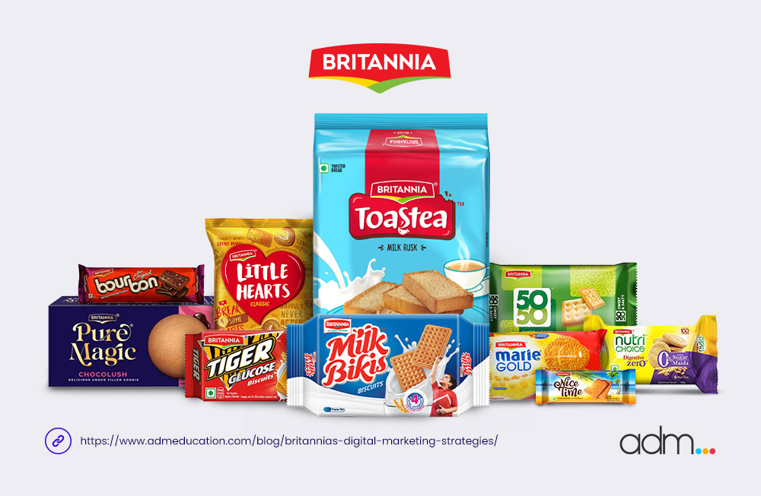
Analyse brand tone and identity

Slide 7
Smart goals and kpis for the same
smart goal is an ultimate outcome or result you want to achieve by accomplishing a set of activities. On the other hand, KPIs are metrics or indicators that tell you whether you're on track to achieve that g

Slide 8
Compitetior analysis
The top competitors of Britannia include Loyka, The Bread Company, Marino, CookieMan India and McVitie's. Britannia has 67 active competitors. Here is a list of the top 10 competitors of Britannia, ranked by Tracxn score: Loyka - Mumbai based, 2017 founded, Seed company

Slide 9
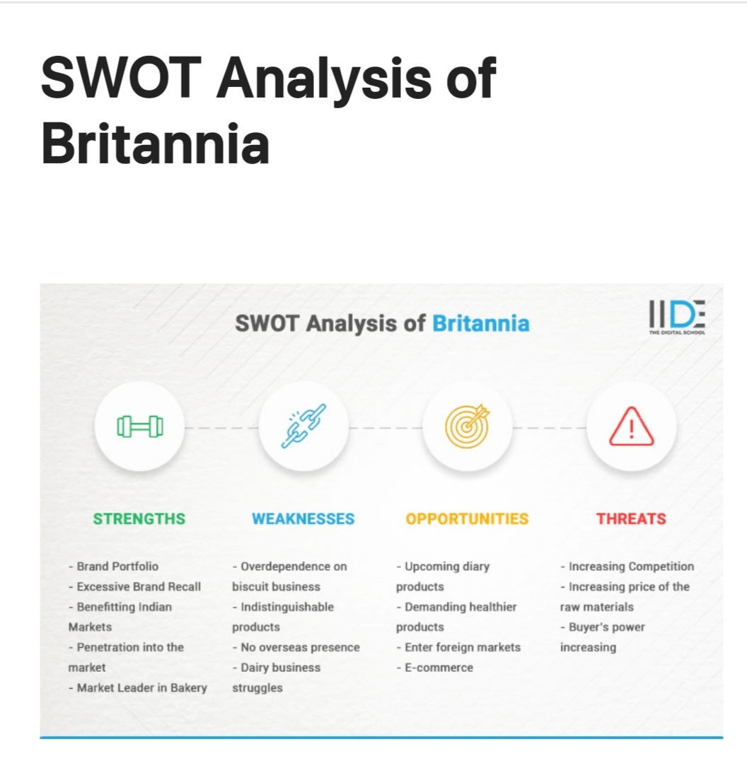

Slide 10
SEO Audit
(SEO) Optimization: Britannia ensures their content is optimized for search engines. They conduct keyword research to identify relevant keywords and seamlessly integrate them into their content. This optimization helps improve their search engine visibility, driving organic traffic to their website.

Slide 11
Keyword research
Keyword Research: Britannia starts by brainstorming and compiling a list of potential keywords and phrases relevant to their products and industry.
They then analyze the keywords used by their competitors and leverage keyword research tools like Google Keyword Planner, SEMrush, or Moz Keyword Explorer to gather data on search volume and keyword difficulty. This helps Britannia identify the most relevant and high-potential keywords for their website.

Slide 12
Define research objectives
To study the sales of various products of Britannia. • To study the marketing strategies of Britannia. • To study the various milestones of the company. • To study the shares of various products in the company.

Slide 13
Brain stone seed keywords:
One of the more powerful uses of Keyword Explorer is its ability to show you the ranking keywords for any website, subfolder, subdomain, or page, including your own.

Slide 14
On page optimization:
On-Page Optimization: Britannia optimizes their website’s on-page elements by incorporating target keywords naturally into meta tags, headings, URLs, and image alt tags. They ensure that these elements provide concise and informative summaries of their web pages, enhancing both user experience and search engine visibility.

Slide 15
Content ideas genaration and strategies :
Content marketing plays a crucial role in Britannia’s digital marketing strategies. They employ several core strategies to create and distribute valuable, relevant, and engaging content. These strategies are specifically designed to attract and engage their target audience while promoting the Britannia brand.

Slide 16
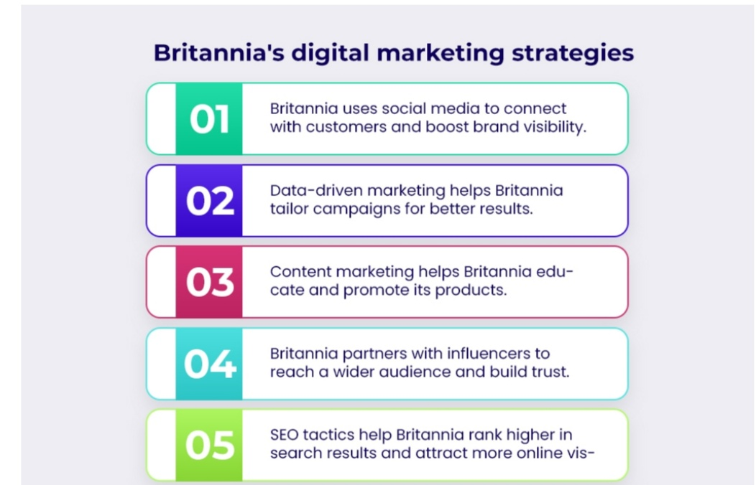

Slide 17
Post creation:
Select Content categories
Comprehensive Content Planning: Britannia begins by conducting thorough research to understand their target audience’s preferences and needs.
Creation of Informative and Engaging Content: Britannia focuses on producing high-quality content that provides value to their audience. They create informative blog posts, articles, recipes, and videos related to their products, food trends, nutrition, and cooking tips. By sharing valuable

Slide 18
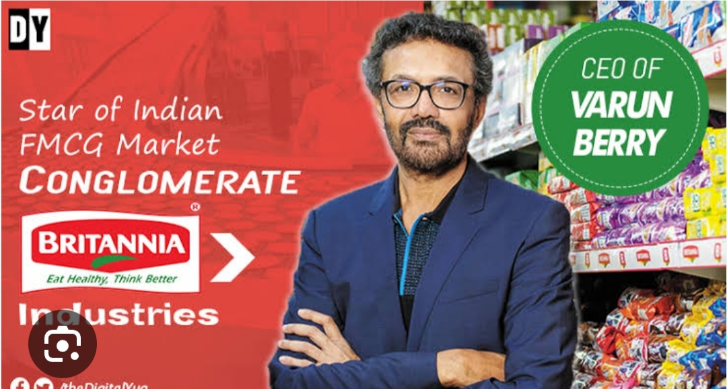

Slide 19
Story link
https://instagram.com/britanniasnackinc?igshid=NTc4MTIwNjQ2YQ==

Slide 20
Team ID:LTVIP2023TMID10375
Team size:5
Team leader:Kolla.Ramdevi
Team member:lutta,devayani
Team member:malleti.krishnaveni
Team member:mamidi.swapna
Team member:mathala.Raghavi

